Slide 1
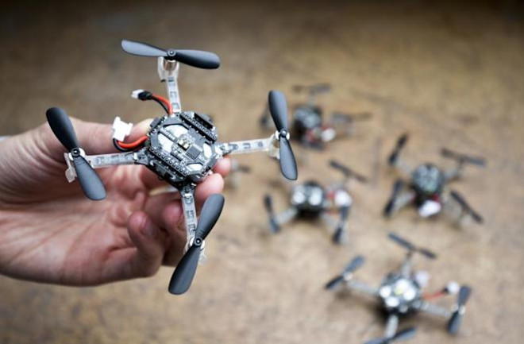
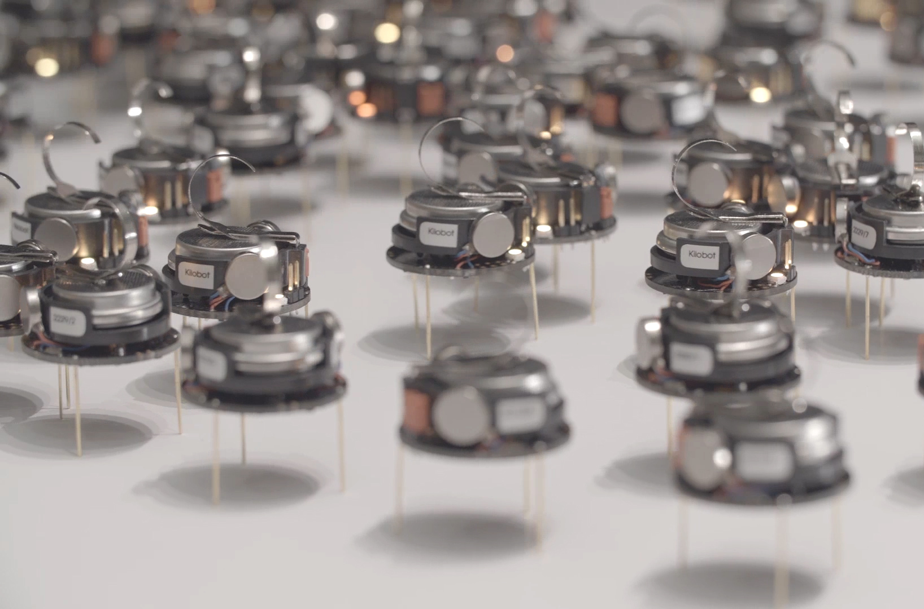
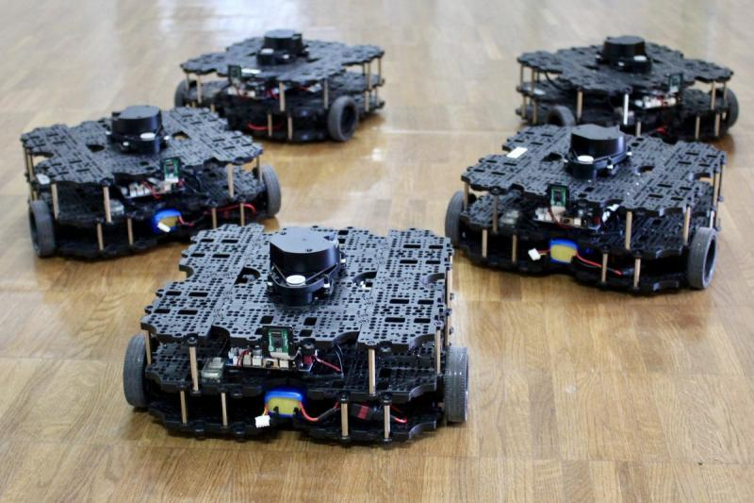

ECE693H, Spring 2025: Multi-robot System Design
“Action 1”
Dr. Daniel Drew

Slide 2
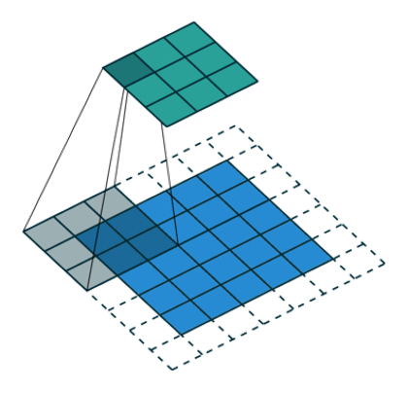
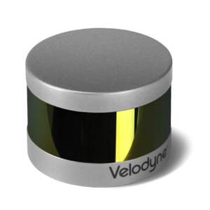
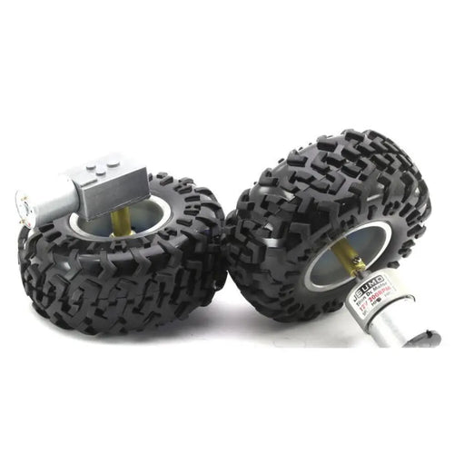
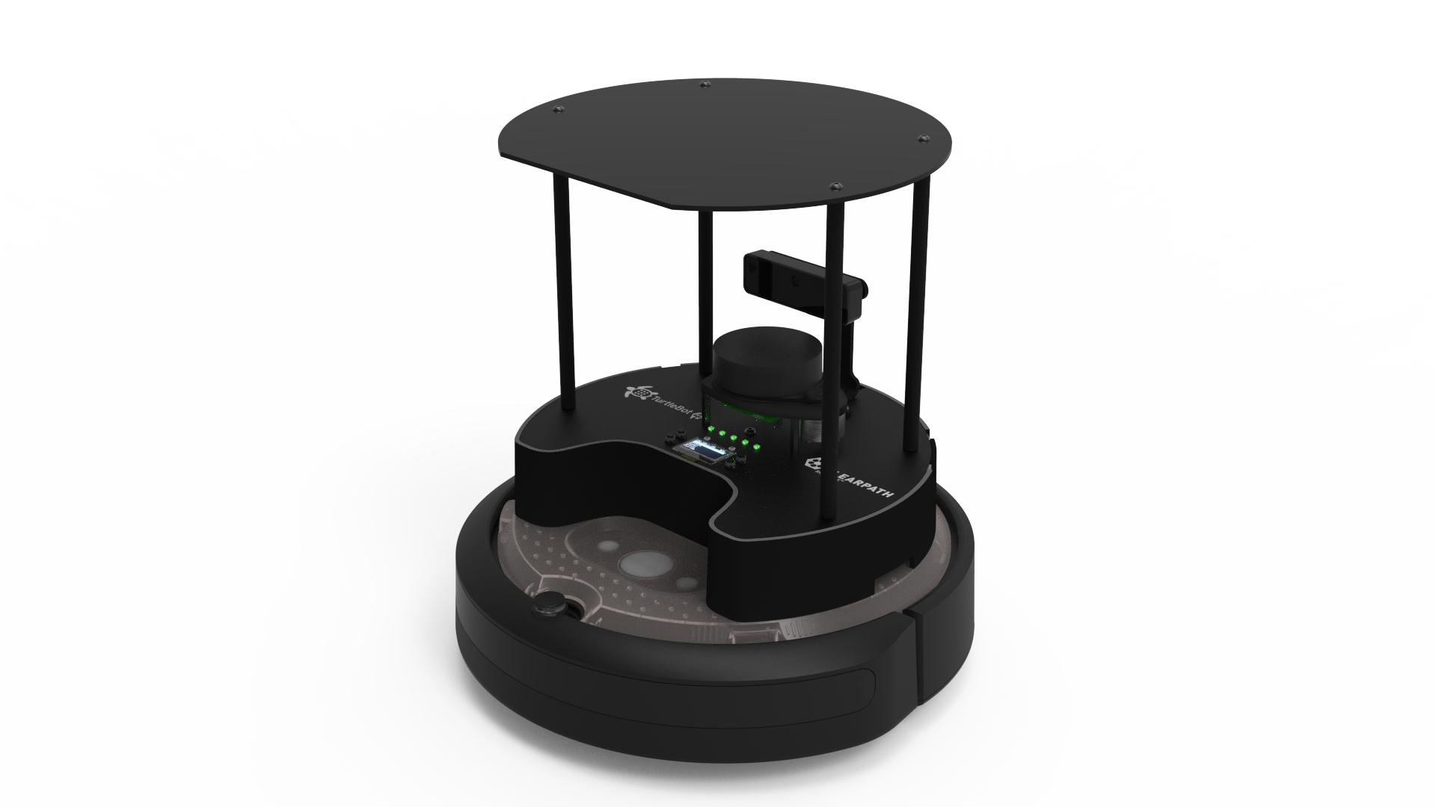
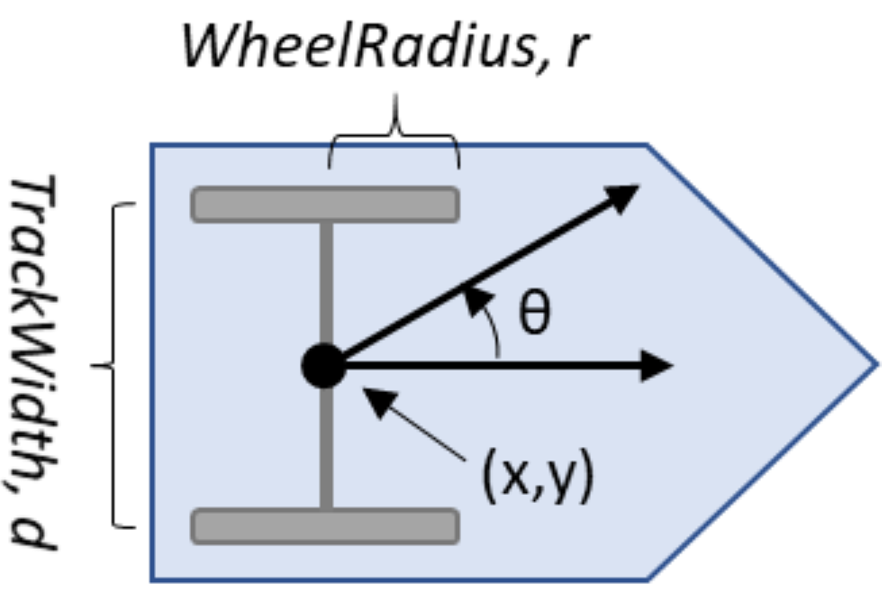
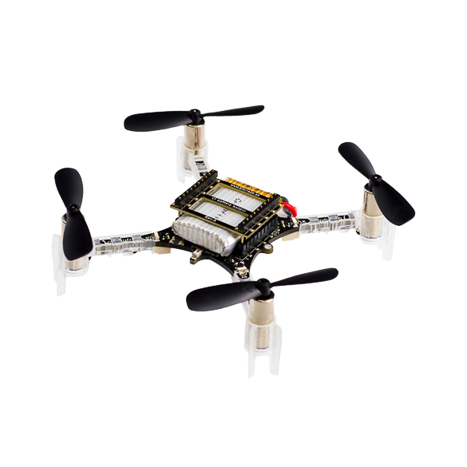
Week 1 Recap
Action
Perception
Intelligence
(not just moving)
(not just sensing)
(not just classification)
Off-the-shelf research platforms let you work at high levels of the stack while abstracting out things like:

Slide 3

Swarm-on-a-Stick
We will create an open-source swarm robotics kit for education, from scratch.

Slide 4
693H Robotic Subsystems
Motors, drive electronics, encoders, PID controllers, top-down tracking
Sensor suite (IMU, prox.), calibration code, general IO (buttons and LEDs)
Mobility
Perception
Compute and Power
Control and Planning
Battery and charging, wireless comms, GPIO and power distribution routing
microROS, ROS2, Gazebo simulation, enclosure design
Mechanics / Prototyping
Coding
PCB Design

Slide 5
Questions?

Slide 6
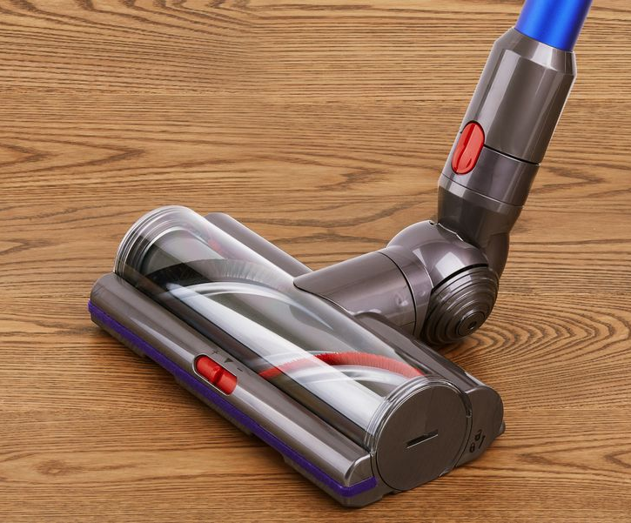
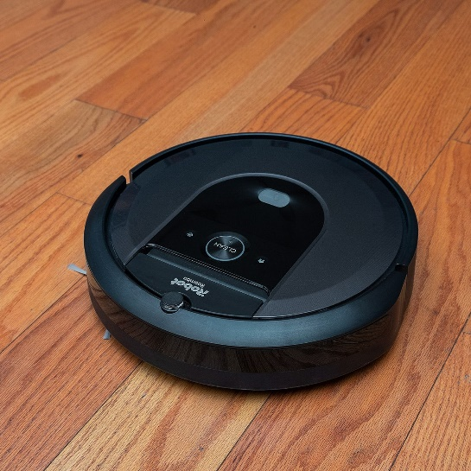
Welcoming New Students
Please share:
Your name and grade level (e.g., ECE senior)
How you heard about this course
What you're excited about in this course
What you're worried about with this course (e.g., technical content, not enough programming experience)
Are neither, one, or both of these examples of robots?
What makes something a robot?

Slide 7
Class Overview
Lecture (~40 minutes)
Subsystem check-in (~5 minutes only)
FabLab training (~4:15pm)

Slide 8
Action: Lecture 1 of 2
Lecture 1: motors → encoders
Lecture 2: motor control → motion planning

Slide 9
Lecture Overview: Ascending the Stack
Electromagnetic motors
Motor gearing and mechanics
Motor driver electronics
Encoders

Slide 10
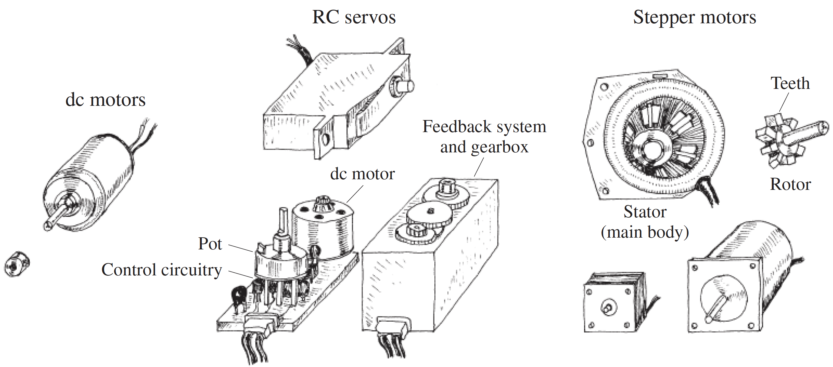
Electromagnetic Motors: Types and Examples

Slide 11
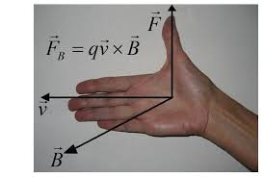
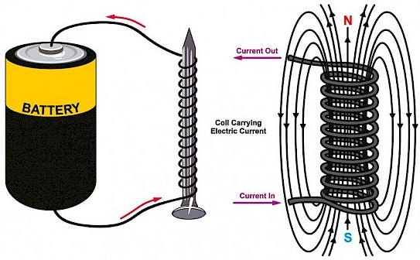
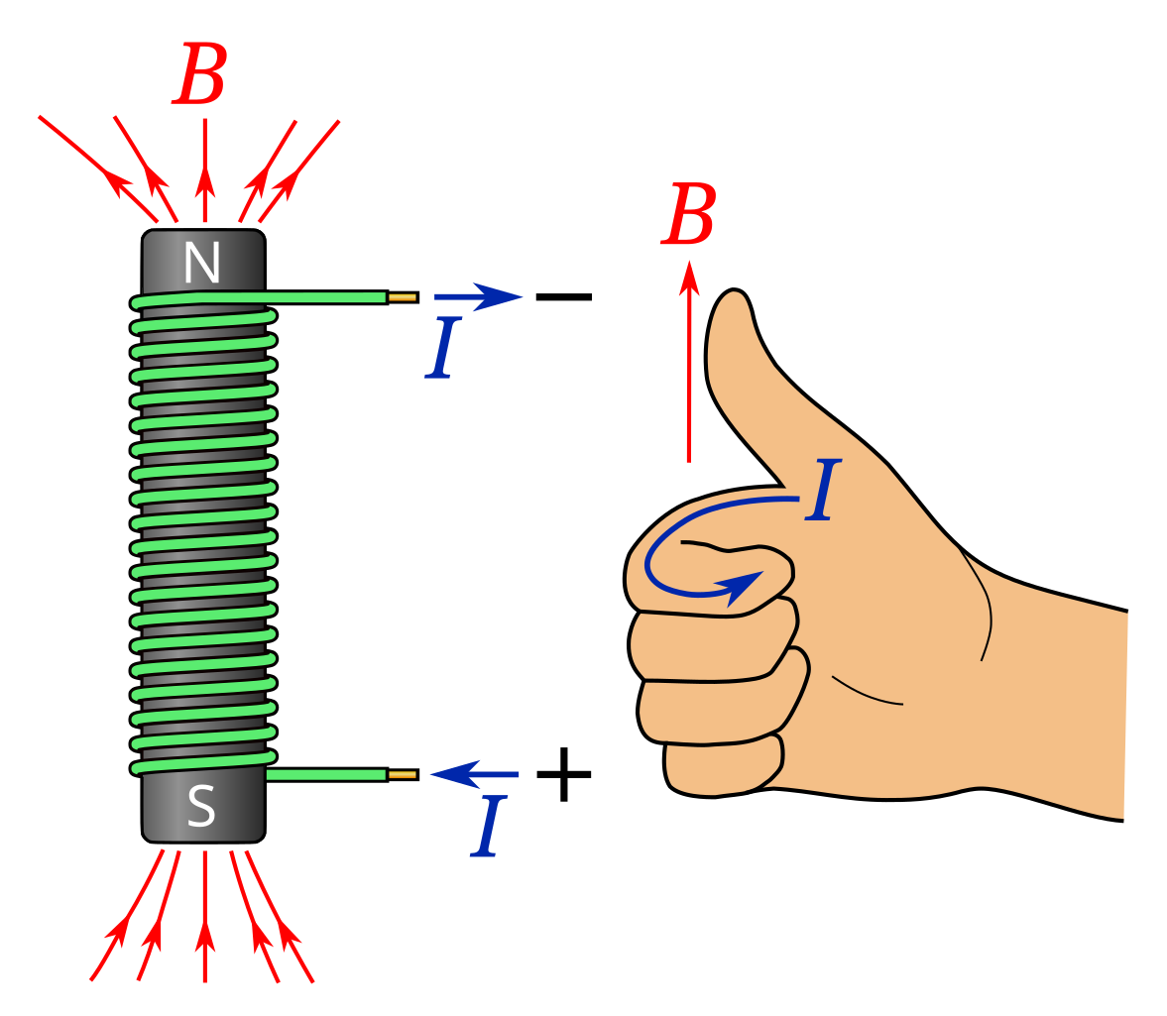
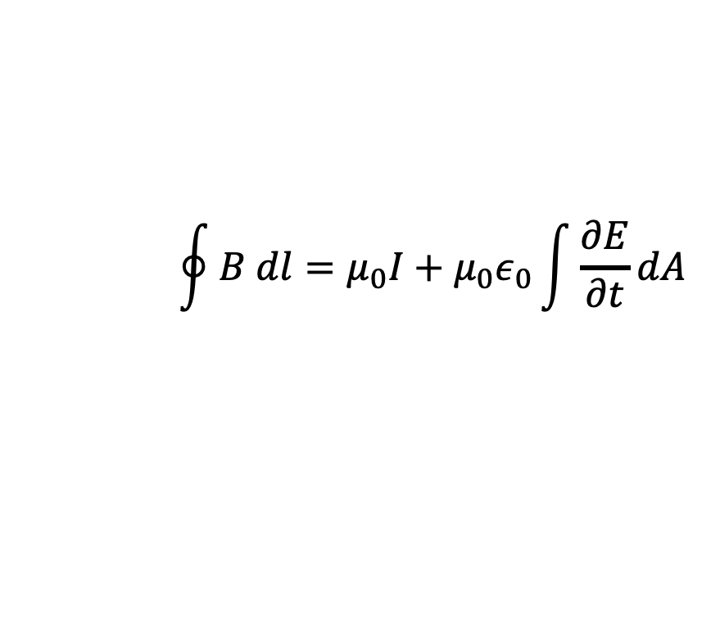
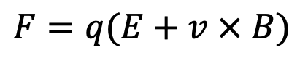
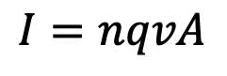
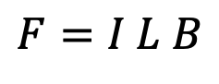
Electromagnetic Motors: Basic Physics
$$\oint{B dl}=μ_{0}I+μ_{0}ε_{0}\int{\frac{∂E}{∂t}dA}$$
Ampere-Maxwell Law
microscopic
macroscopic, net force on current-carrying conductor
Lorentz force
$$F=q(E+v × B)$$
$$F=I L B$$
$$I=nqvA$$
(curl right hand rule for electromagnets)

Slide 12
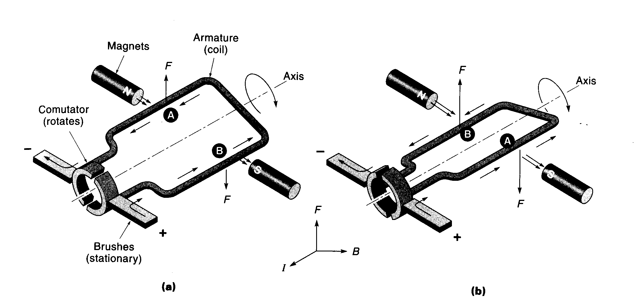
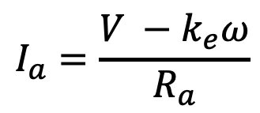
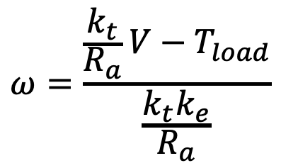
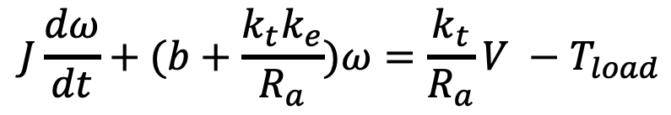
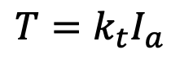
Electromagnetic Motors: Basic Physics
“back emf” constant
motor torque constant
$$I_{a}=\frac{V −k_{e}ω}{R_{a}}$$
$$T=k_{t}I_{a}$$
armature current
armature torque
$$J\frac{dω}{dt}+(b+\frac{k_{t}k_{e}}{R_{a}})ω=\frac{k_{t}}{R_{a}}V −T_{load}$$
full equation of motion
$$ω=\frac{\frac{k_{t}}{R_{a}}V−T_{load}}{\frac{k_{t}k_{e}}{R_{a}}}$$
steady state velocity

Slide 13
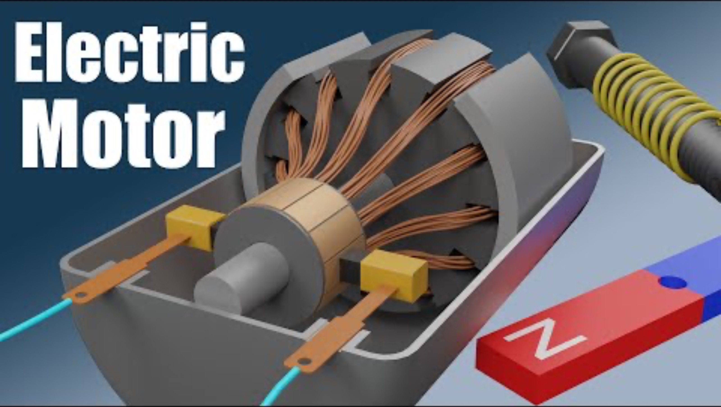
Electromagnetic Motors: Brushed DC Motor
7:10

Slide 14
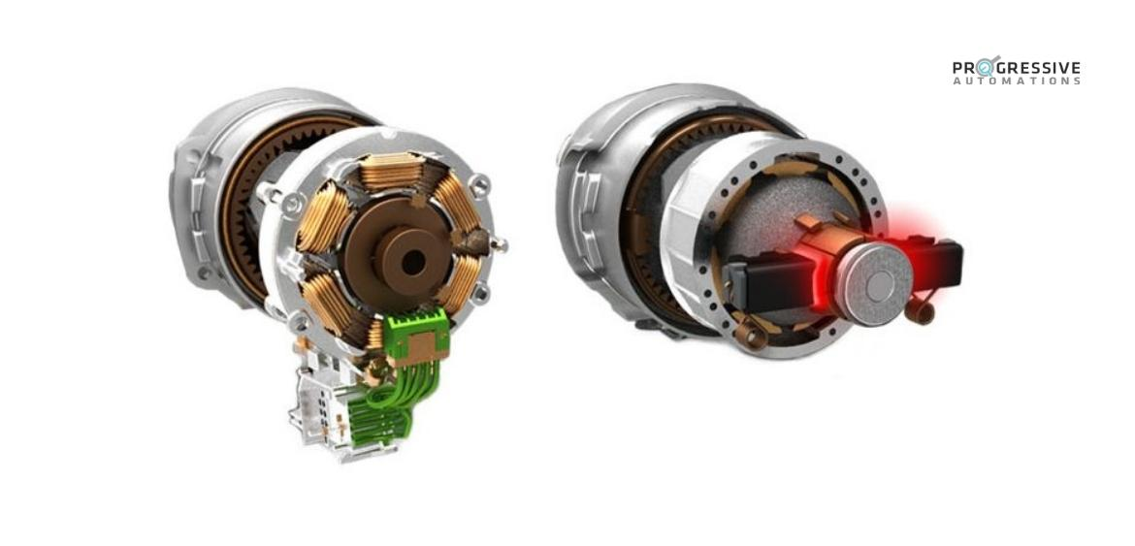
Electromagnetic Motors: Brushed vs Brushless

Slide 15
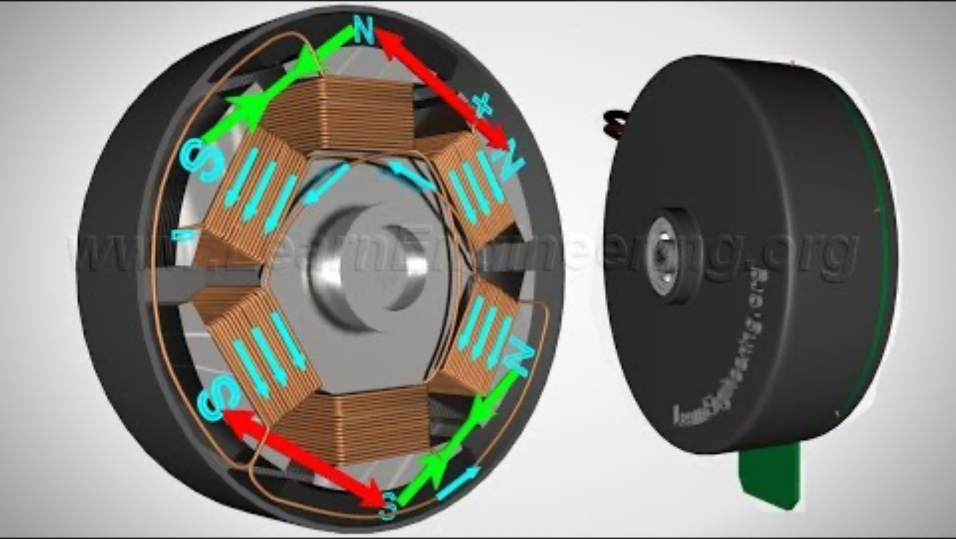
Electromagnetic Motors: Brushless DC Motor
2:40

Slide 16
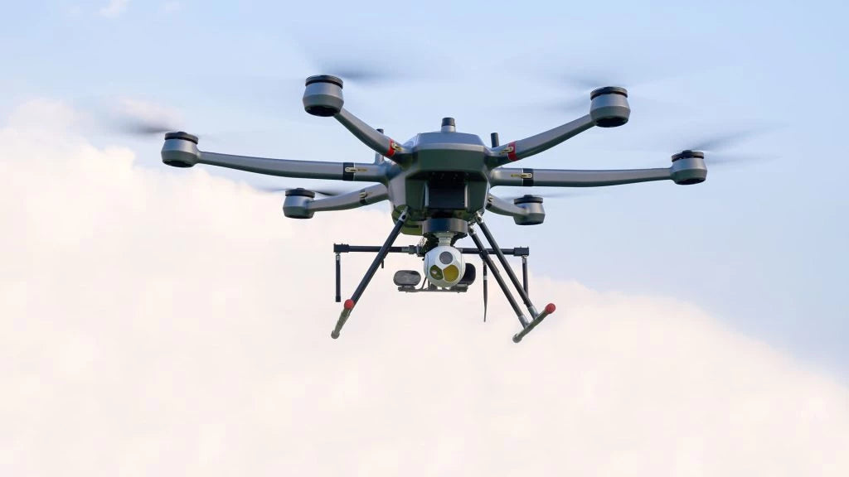
Electromagnetic Motors: Brushed vs Brushless
Rotor vs stator: In brushed motors, the rotor has the electromagnet and the stator has permanent magnets. Brushless are the opposite.
Physical contact vs control complexity: Brushed motors use physical contact for commutation. Brushless motors require electronic controller to time the switching.
High performance vs cost and integration simplicity: Brushless motors are better by every metric, but are more expensive and more complex to integrate.
Brushed
Brushless

Slide 17
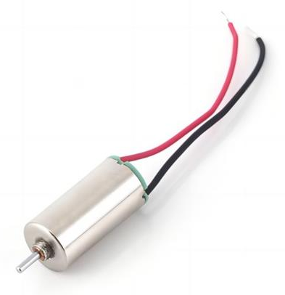
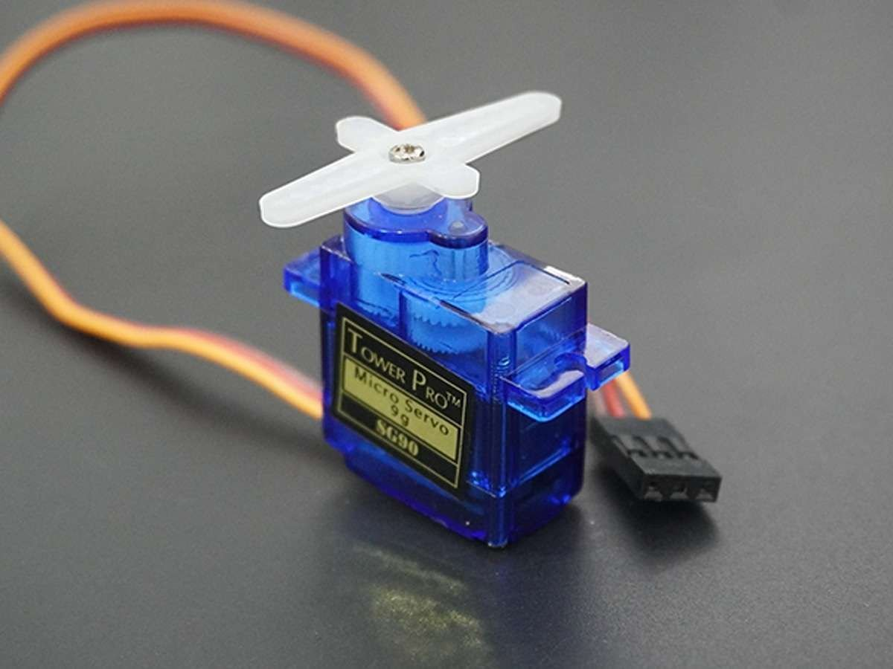
Electromagnetic Motors: Servos
DC motor
RC servo

Slide 18
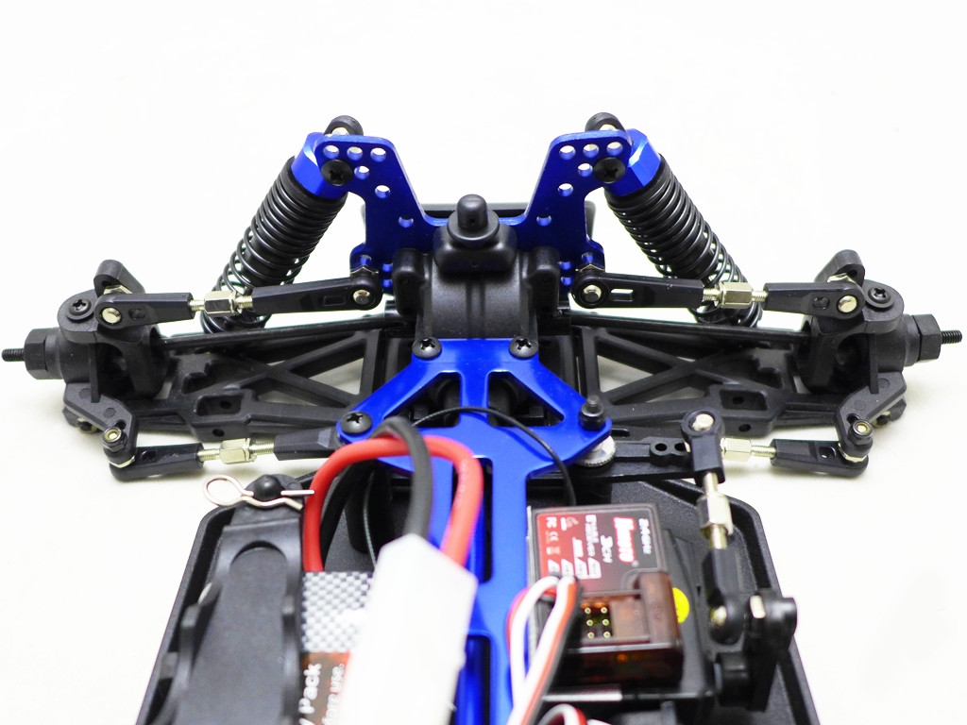
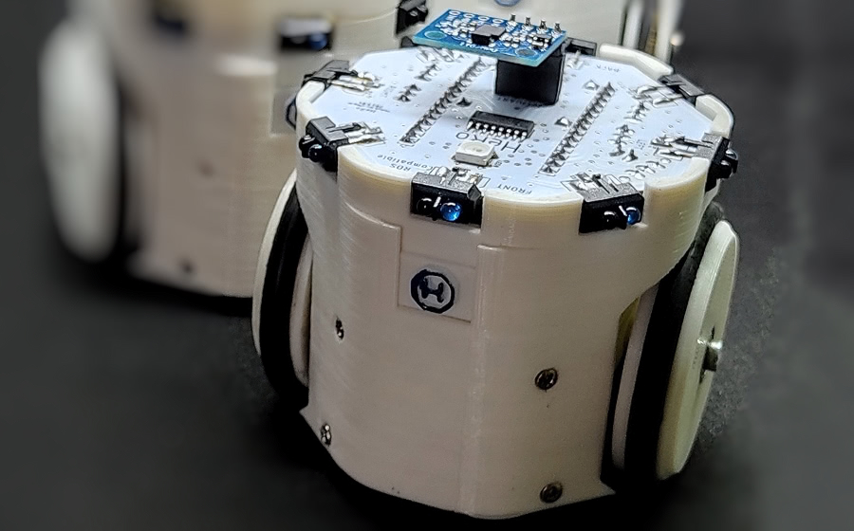
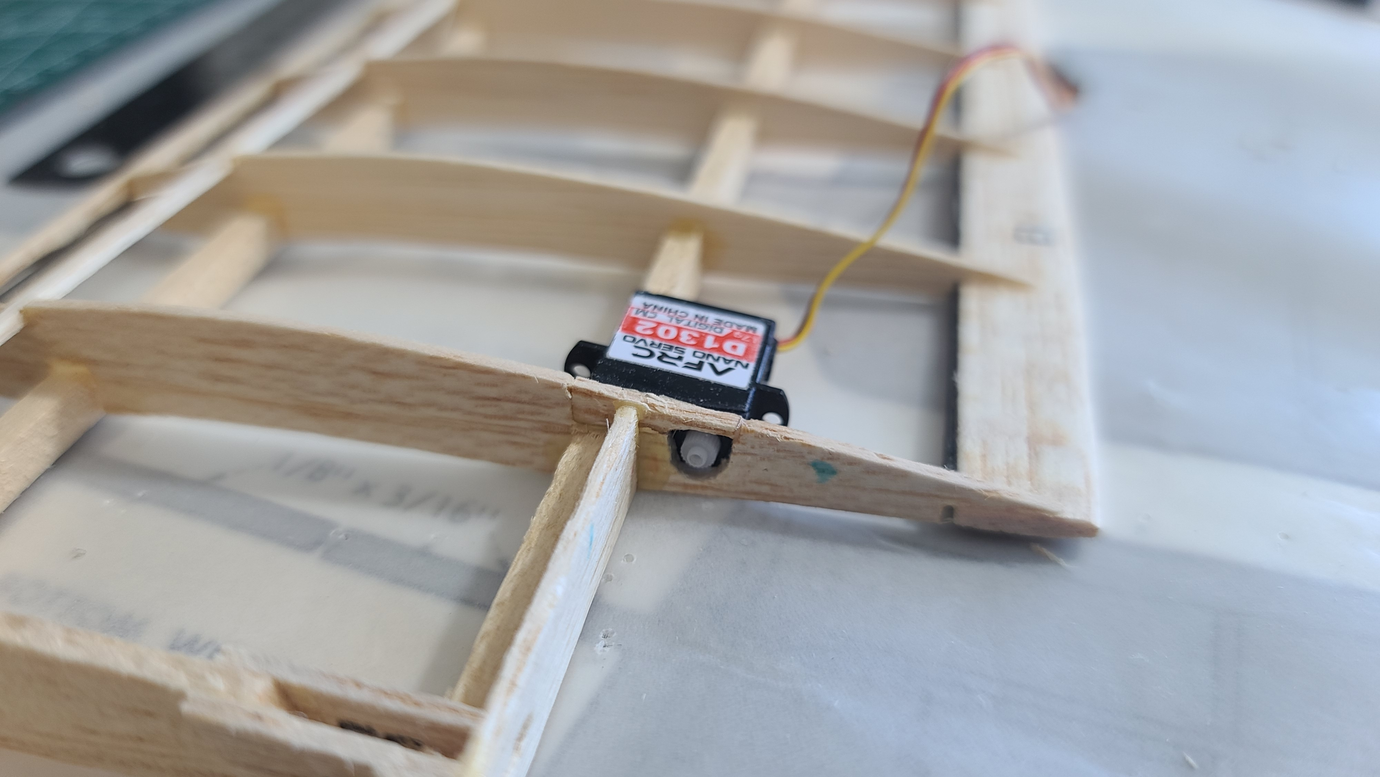
Electromagnetic Motors: Servos
steering
main drive
(continuous servo)
RC servo
flap control

Slide 19
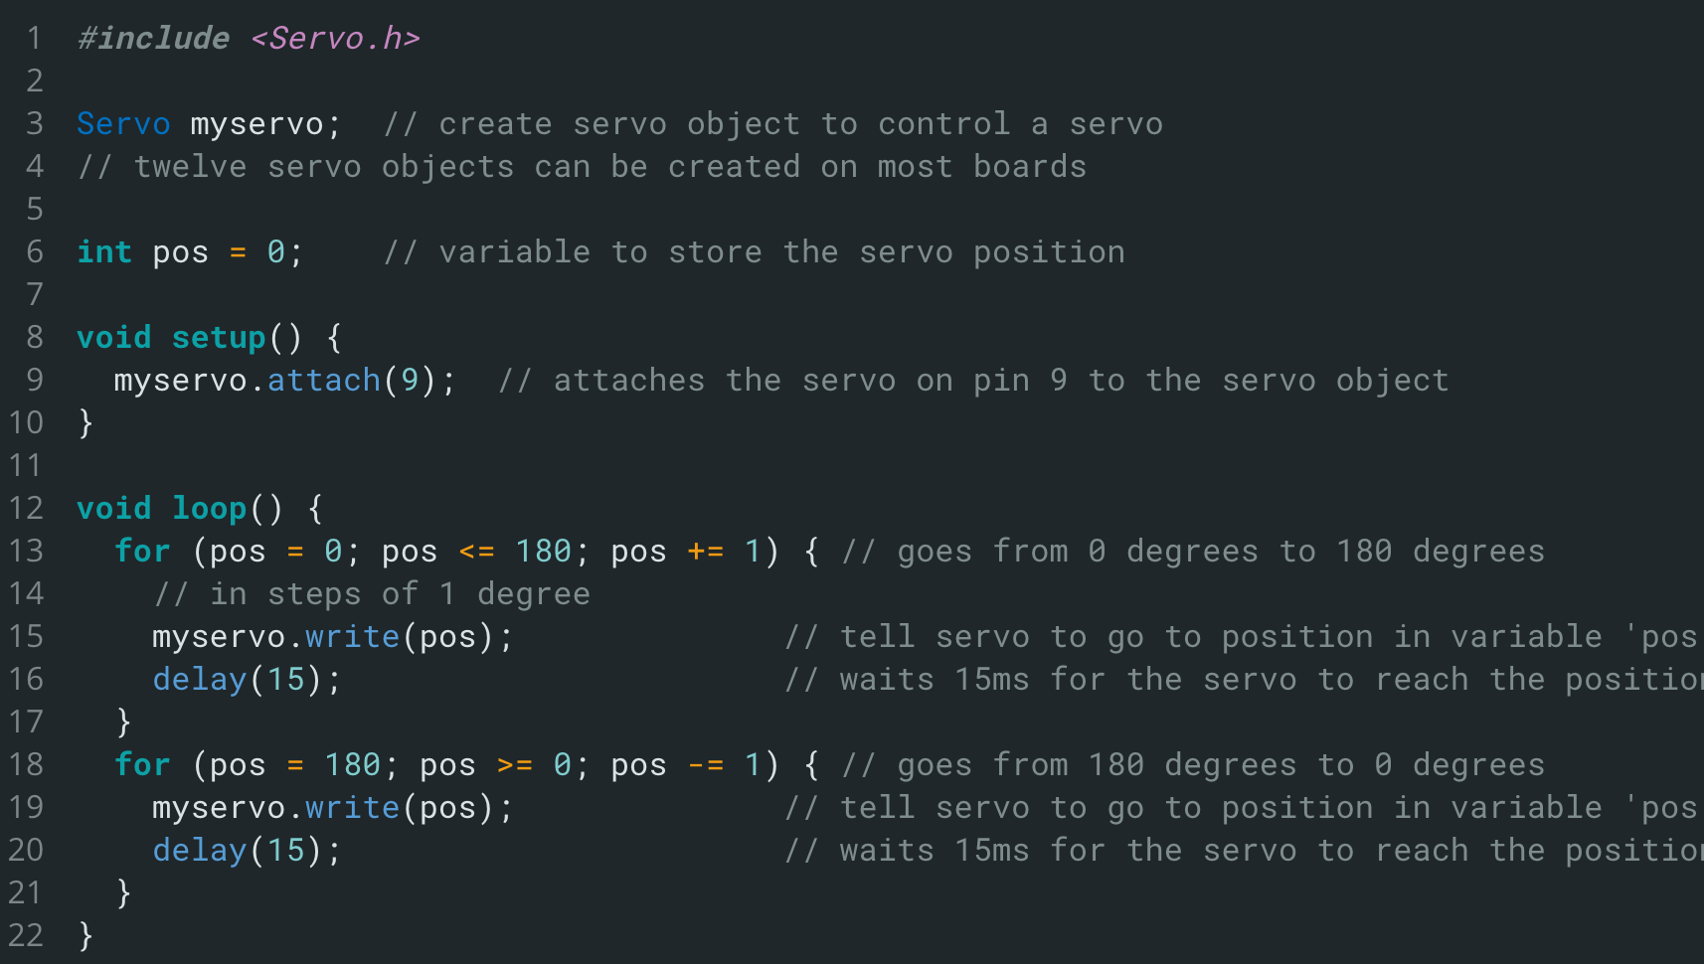
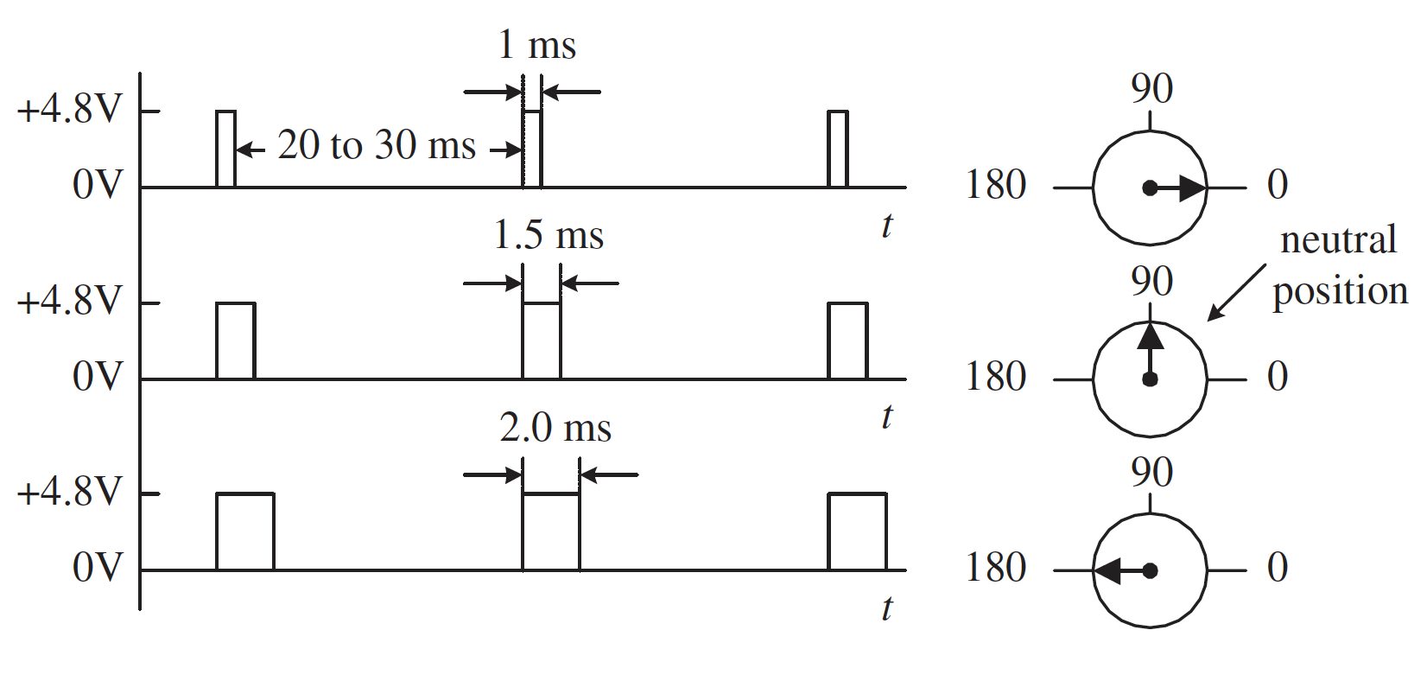
Electromagnetic Motors: Servos
typical use
what’s actually happening?
but what’s ACTUALLY happening?

Slide 20
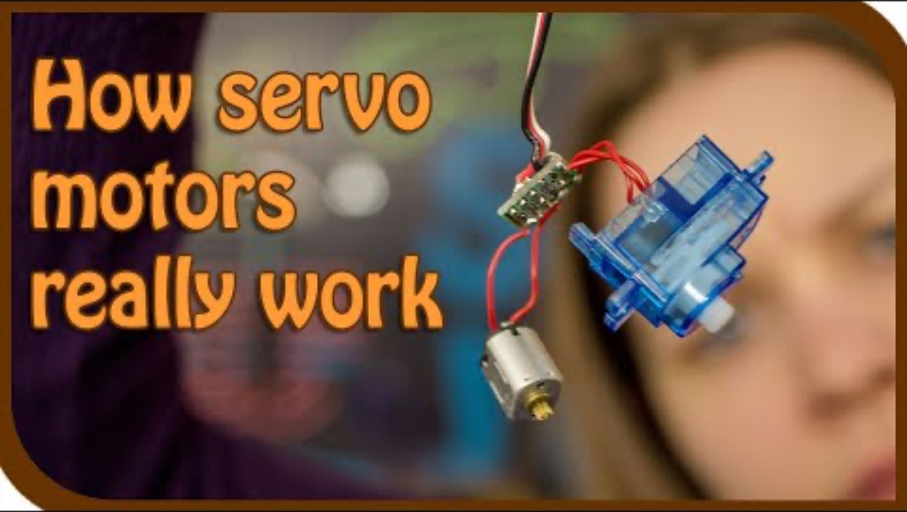
Electromagnetic Motors: Servos
4:10

Slide 21
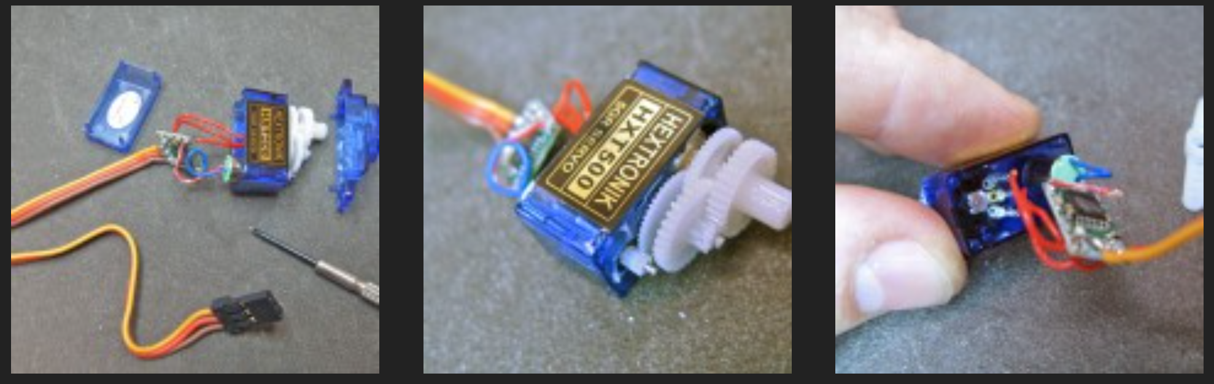
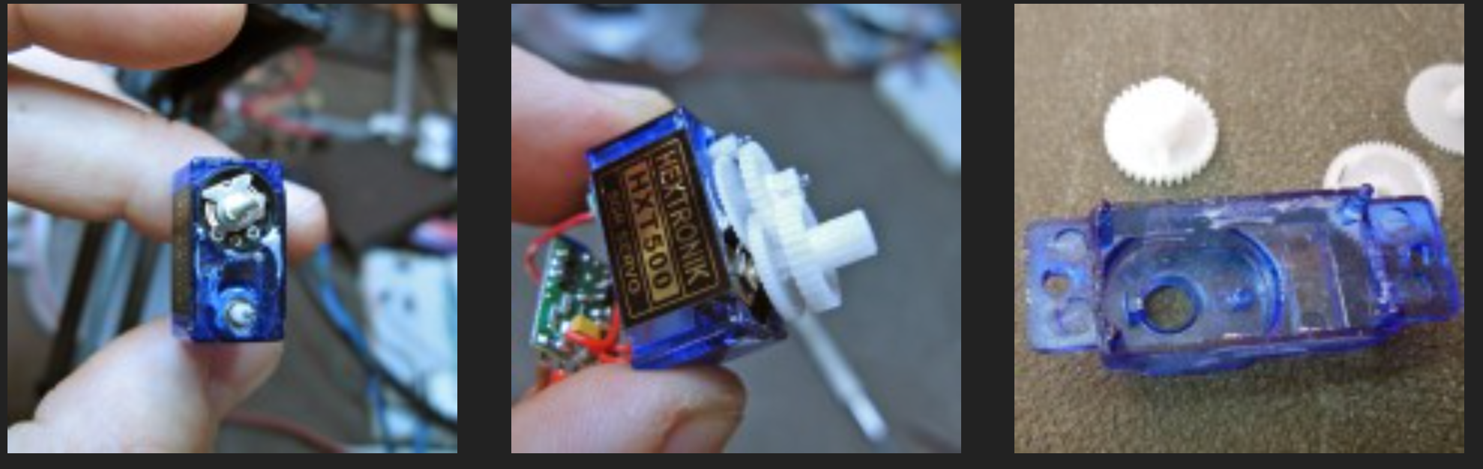
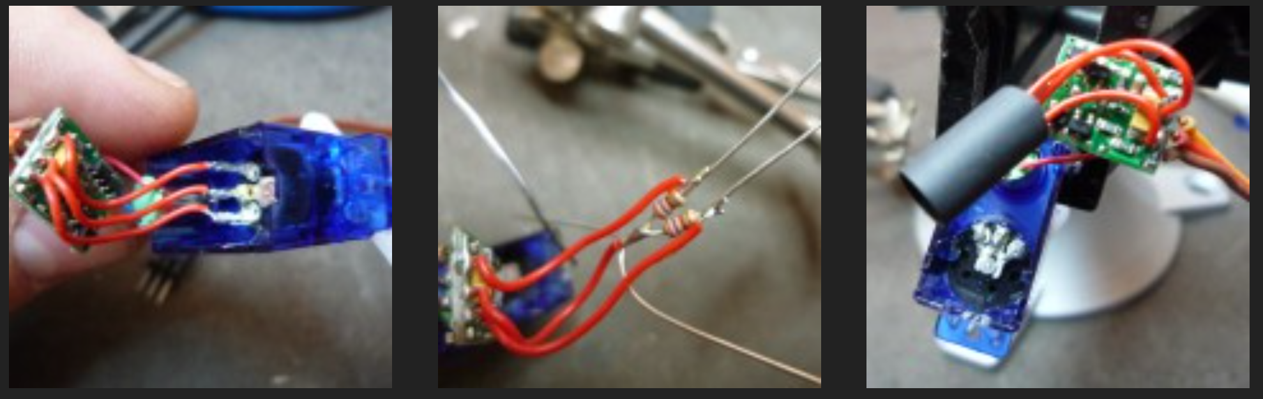
Servo Hacking
as seen in…

Slide 22
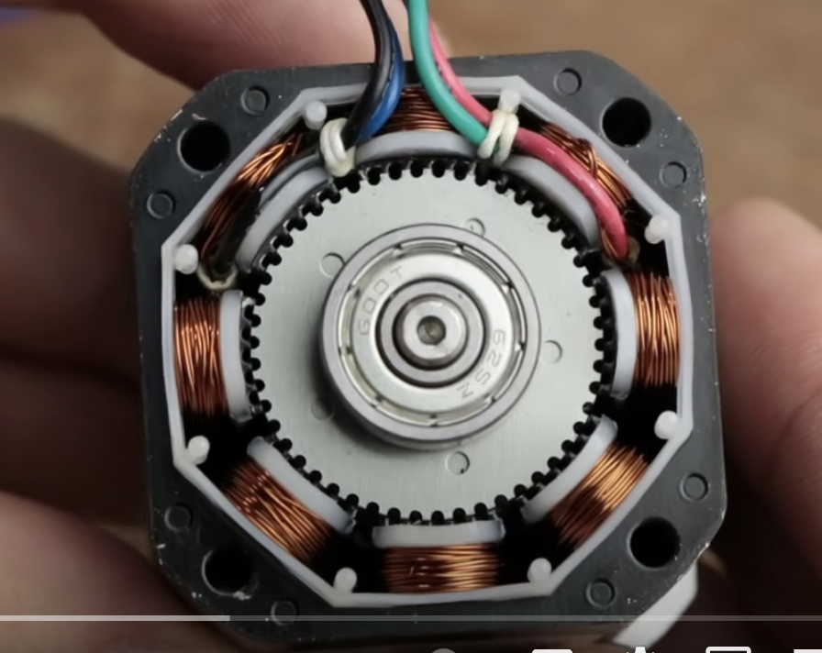
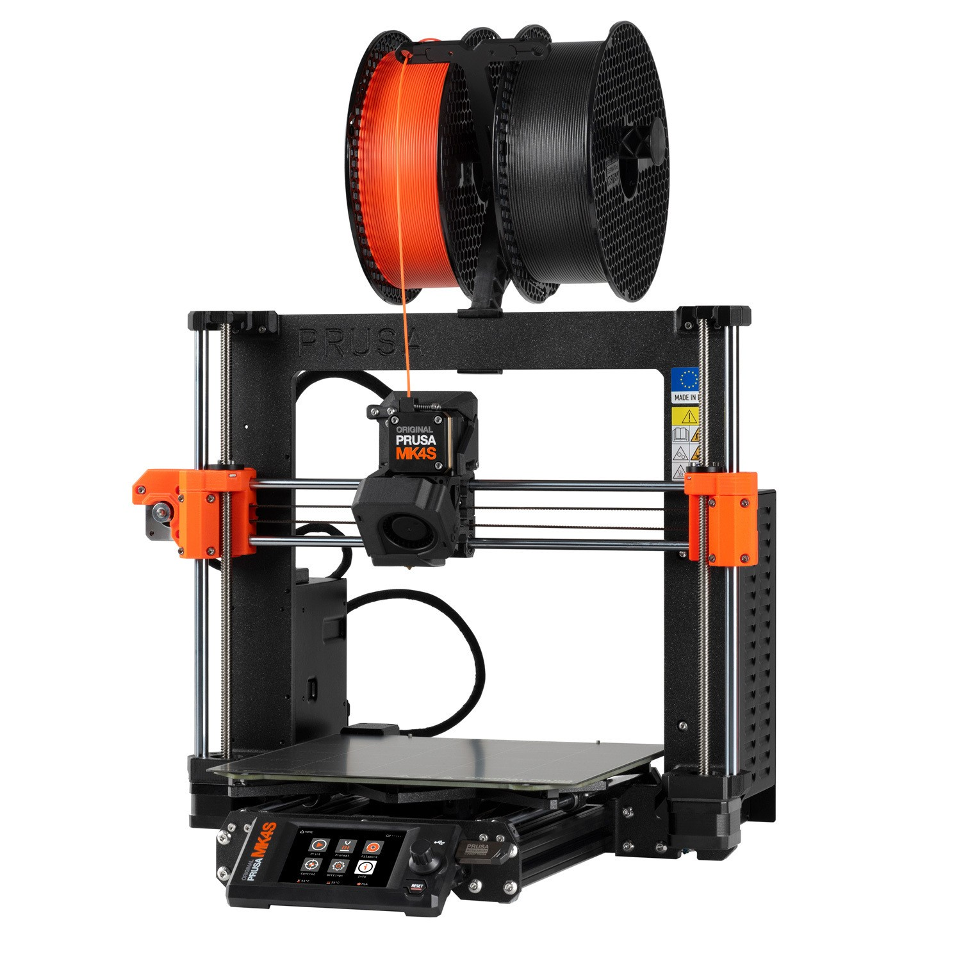
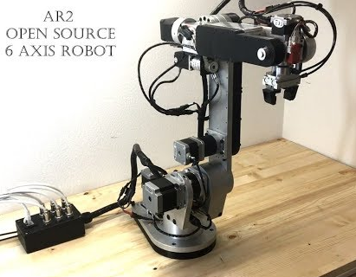
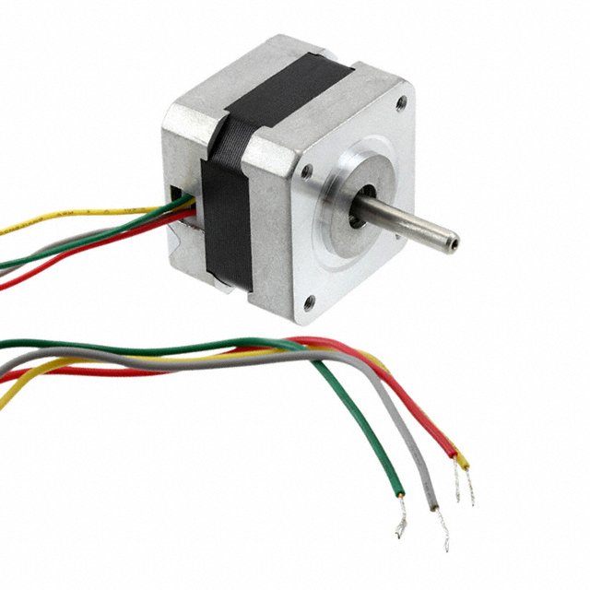
Electromagnetic Motors: Steppers
very small step sizes, high torque, “easy” to control precisely, relatively cheap for performance you get

Slide 23
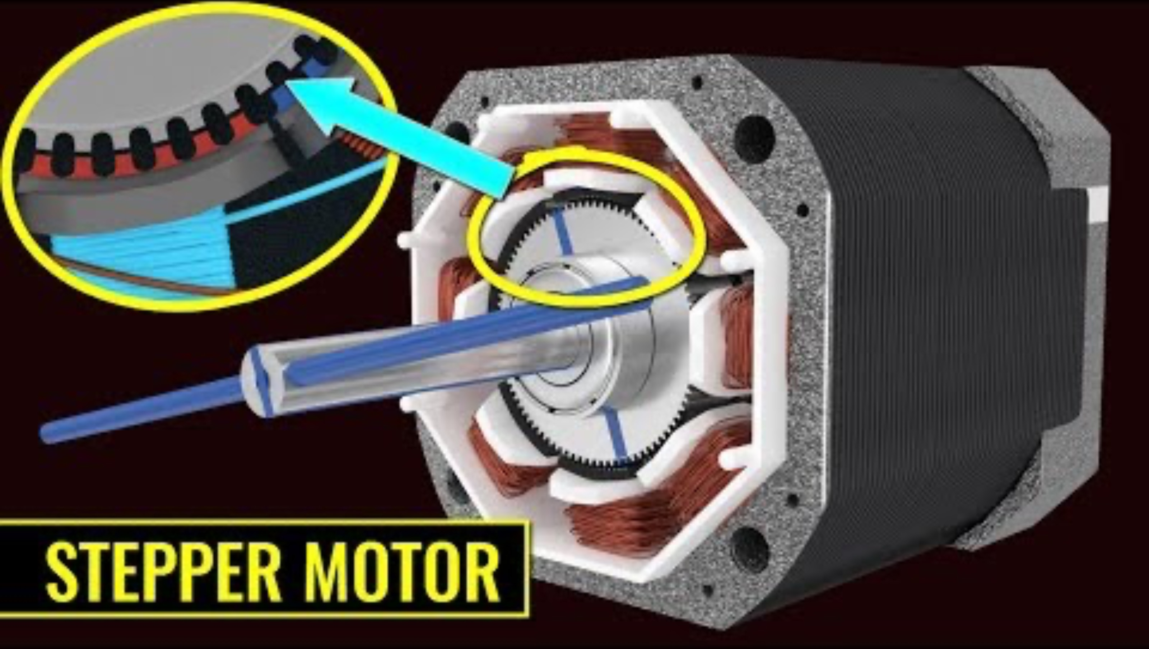
Electromagnetic Motors: Steppers
5:11

Slide 24
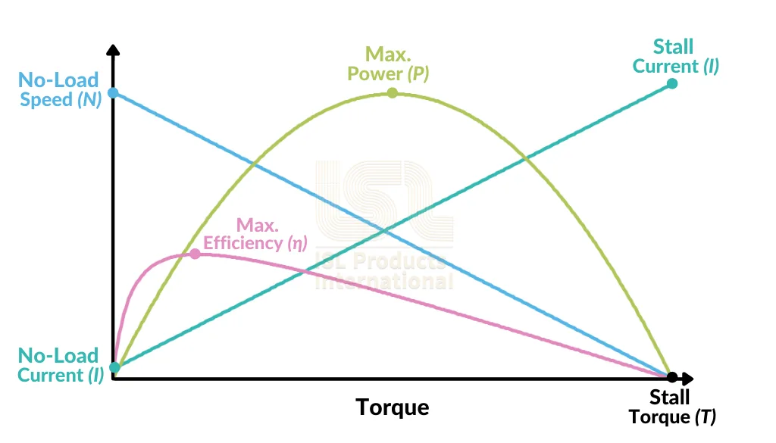
DC Motor Gearing
(recommended to operate dc motor at no more than 25% of stall current)

Slide 25
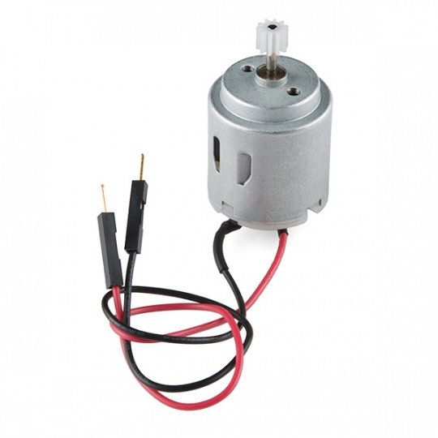
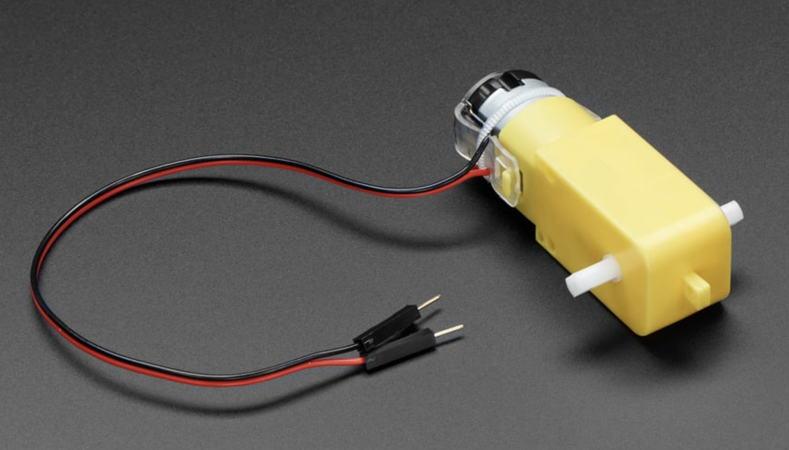
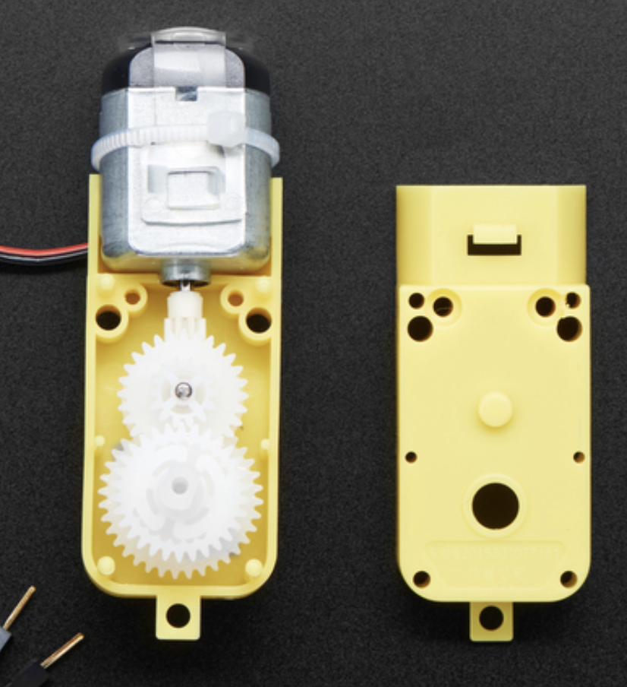
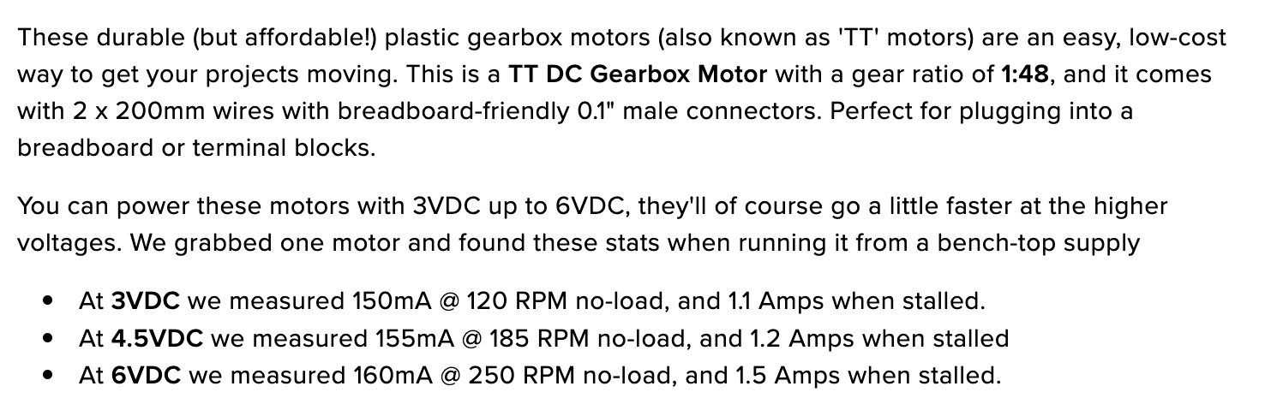
DC Motor Gearing
No load speed：6600rpm
Stall current：0.8A。
Torque requirement for 500g robot, driving 0.5m/s, with 2.5cm radius wheels, is on the order of 13mNm at ~200RPM

Slide 26
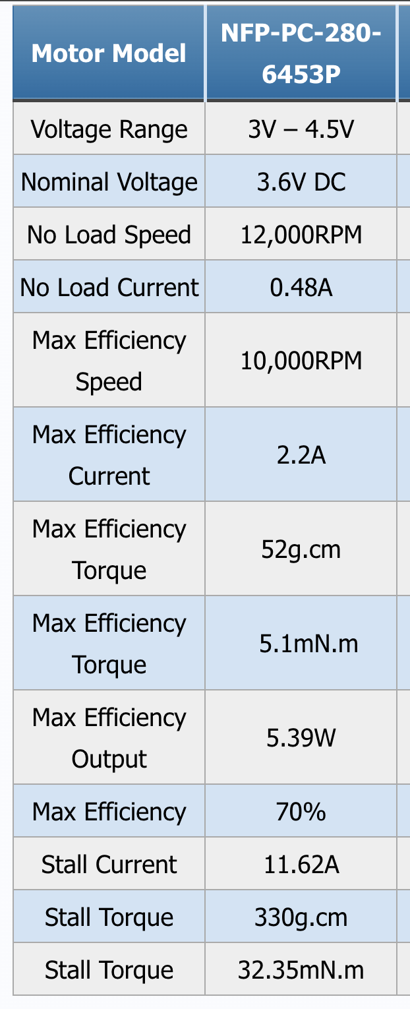

DC Motor Gearing
Torque requirement for 500g robot,
driving 0.5m/s, with 2.5cm radius wheels,
is on the order of 13mNm at ~200RPM
No load speed：6600rpm
Stall current：0.8A。
Stall current = ~10x hobby motor
Max eff. torque / 10 = 0.5mNm
6600 RPM / 48 = ~140 RPM
0.5mNm * 48 = ~24 mNm
25% of 24 = 6mNm
Two motors => 12mNm total torque
1:48 gear ratio

Slide 27





Motor Drivers: H-Bridges – Motivation
How would we power the motor?

Slide 28

Motor Drivers: H-Bridges – What and Why
Build up to h bridge components one by one
4:36

Slide 29

Motor Drivers: H-Bridges at a High Level
2:45

Slide 30





Encoders: Integration and Use
$\left[x, y\right]=$ Vehicle position
$\dot{φ} =$ Wheel speed
$ω =$Vehicle heading angular velocity
Incremental encoders are typical for mobility
Quadrature encoders give direction

Slide 31






Encoders: Integration and Use
1:120 TT motor
Magnetic quadrature encoder
Integrated
Hall effect sensors

Slide 32
Encoders: Integration and Use
“12 CPR”
Counts per revolution of wheel shaft: CPR * gear ratio
To calculate RPM: counts since last read / delta t
e.g.,
counts = encoder.counts – last_counts
countspersec = counts / deltat
rpm = countspersec * (60 / (12*120))

Slide 33
Lecture (~40 minutes)
Subsystem check-in (~5 minutes only)
FabLab training (~4:15pm)
Questions?
Questions?
Lecture 1: motors → encoders
Lecture 2: motor control → motion planning

Slide 34
693H Robotic Subsystems
Motors, drive electronics, encoders, PID controllers, top-down tracking
Sensor suite (IMU, prox.), calibration code, general IO (buttons and LEDs)
Mobility
Perception
Compute and Power
Control and Planning
Battery and charging, wireless comms, GPIO and power distribution routing
microROS, ROS2, Gazebo simulation, enclosure design
Mechanics / Prototyping
Coding
PCB Design

